Slide 1
BASIC QUANTUM THEORY Lecture 2: Atomic Theory
Learning Outcomes
You are able to:
Draw connections between the H emission spectrum and quantized energy levels.
Describe Bohr’s model of the H atom.
Describe the shapes and sizes of orbitals designated s, p, and d.
Learn how principal energy levels fill with electrons.
Differentiate between core and valence electrons.
Write electron configurations for atoms and ions.

Slide 2
Electromagnetic Radiation
Classical physics says matter made up of particles, energy travels in waves
Electromagnetic Radiation is radiant energy, both visible and invisible
Electromagnetic radiation travels in waves
All waves are characterized by their velocity, wavelength, amplitude, and the number of waves that pass a point in a given time.
The wavelength of electromagnetic radiation has the symbol λ.
Wavelength is the distance from the top (crest) of one wave to the top of the next wave.
Measured in units of distance such as m, cm, Å.
1 Å = 1 x 10⁻¹⁰ m = 1 x 10⁻⁸ cm
The frequency of electromagnetic radiation has the symbol υ
Frequency is the number of crests or troughs that pass a given point per second.
Measured in units of Hz (Hertz) (Cycle / Second). [ 1/ Time]. S⁻¹

Slide 3
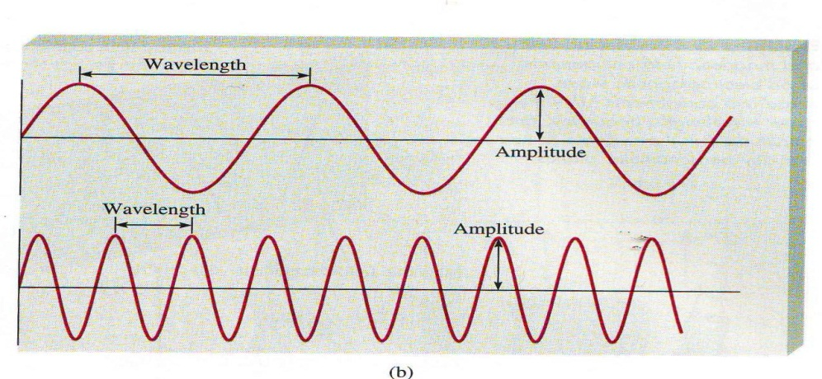
Figure 1: A light wave The relationship between wavelength and frequency for any wave is; Velocity = λ υ For electromagnetic radiation the Velocity ( c ) is 3.00 x 10⁸ m/s. Thus c = λ υ for electromagnetic radiation.

Slide 4
Figure 2: The different wavelengths of electromagnetic radiation

Slide 6
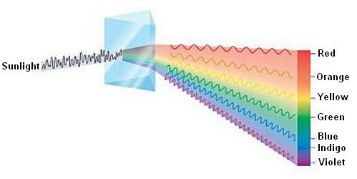
Absorbed colourالضوء الممتص | λ (nm) | observed colourالضوء المنبعث | λ (nm)
violet | 400 | Green-yellow | 560
Blue | 450 | yellow | 600
Blue-green | 590 | red | 620
Yellow-green | 570 | violet | 410
yellow | 580 | Dark blue | 430
orange | 600 | blue | 450
Red | 650 | green | 520

Slide 7
In 1900 Max Planck studied black body radiation and realized that to explain the energy spectrum he had to assume that:
1- Energy is quantized
2- Light has particle character (called photon)
The energy of photon is directly proportional to the frequency of light, Planck’s equation is:
E = h υ or E = $\frac{hC}{λ}$
h = Planck’s constant = 6.626 x 10⁻³⁴ J . s

Slide 8
Example 2:
1) What is the energy of a photon of green light with wavelength 5200 Å?
2) What is the energy of 1.00 mol of these photons?
Ans./
From Example 1, we know that υ = 5.77 x 10¹⁴ s⁻¹
E = h υ
E = (6.626 × 10⁻³⁴J.s) (5.77 × 10¹⁴ s⁻¹ )
E = 3.83 × 10⁻¹⁹ J per photon
For 1.00 mol of photons:
(6.022 × 10²³ photons)(3.83 × 10⁻¹⁹J per photon) = 231 kJ/mol

Slide 9
Example 3:
Calculate the speed of a light whose wave length and frequency are 17.4 cm and 87.4 Hz, respectively.
Ans./ c=λʋ= 17.4 cm x 87.4 /sec = 1.52 x 10³ cm/sec.
Example 4:
An orange line of wavelength 5890 Å is observed in the emission spectrum of sodium.
What is the energy of one photon of this orange light?
Ans./ $λ$= 5890 Å [$\frac{1 ×10 _10}{\text{Å}}$ ] = 5.890 × 10⁻⁷ m
E = h υ = $\frac{hC}{λ} = \frac{\text{(}\text{6.}\text{626 }\text{×} \text{10}\text{−}\text{34}\text{J}\text{.}\text{s}\text{ ) (}\text{3.00 }\text{x} \text{108 }\text{m}\text{/}\text{s}\text{)}}{\text{5.}\text{890 }\text{×} \text{10}\text{−}\text{7 }\text{m}}$
E = 3.375 ×10⁻¹⁹ J

Slide 10
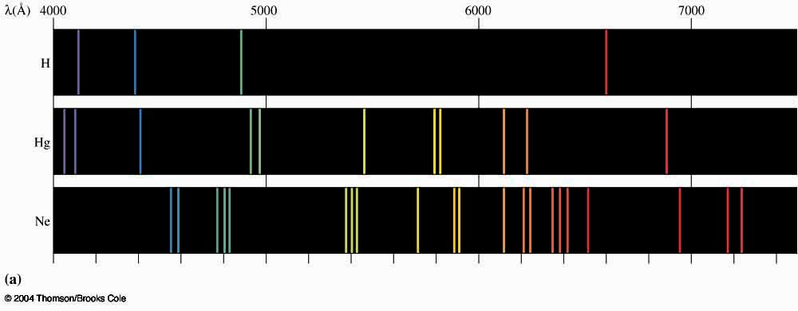
Atomic Spectra
Atoms which have gained extra energy release that energy in the form of light.
The light atoms give off or gained is of very specific wavelengths called a line spectrum.
light given off = emission spectrum.
light energy gained = absorption spectrum.
extends to all regions of the electromagnetic spectrum.
Every element has a unique spectrum which can use spectra to identify elements: (Figure 3)

Slide 11
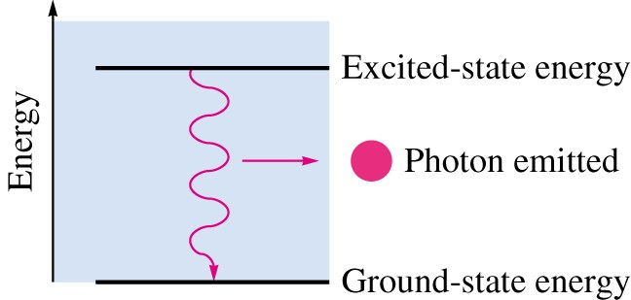
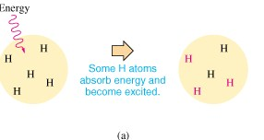
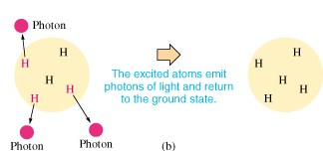
Figure 4: (a) Absorption and (b) Emission Processes
Figure 5: When an excited H atom returns to a
lower energy level, it emits a photon that
contains the energy released by the atom
Absorption
(
a
)
Emission

Slide 12
Atomic Spectra
The line spectrum must be related to energy transitions in the atom.
Absorption = atom gaining energy
Emission = atom releasing energy
Since all samples of an element give the exact same pattern of lines, every atom of that element must have only certain, identical energy states
The atom is quantized
If the atom could have all possible energies, then the result would be a continuous spectrum instead of lines

Slide 13
Black body radiation
When a solid object is heated to about 1000K, it began to emit a visible light as in the soft red glow of smoldering coal.
At about 1500K, the light is brighter and more orange, as from the heating coil of a toaster.
At temperature's greater than 2000K, the light is still brighter and whiter, as from a piece of white-hot iron or the filament of the light bulb.
The phenomenon of changing intensity and wave length of the light
emitted as a dense object is heated is called " black body radiation" because it approximates the light given off by a hot blackbody, one that absorb all radiation falling on it.
Wien noticed that the emitted energy from a hot body appeared as a contineous spectrum, its wave lengths varies according to applied heat.

Slide 14
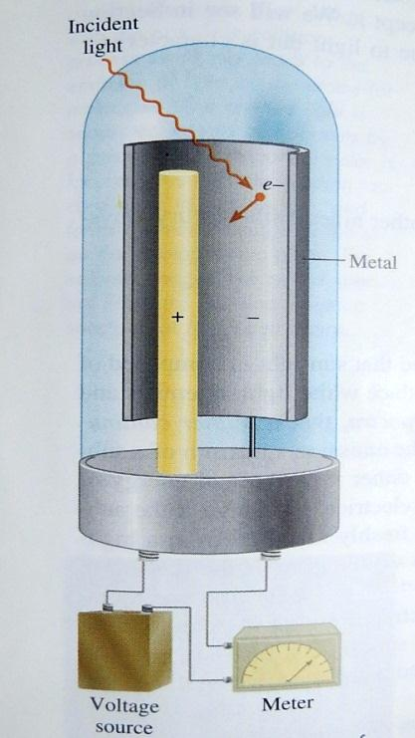
The Photoelectric Effect
- In 1905 , Albert Einstein used Plank's Quantum theory
in physics, The Photoelectric Effect, a phenomenonin which
(electrons are ejected from the surface of a certain metal
exposed to light of at least a certain minimum frequency,
called the threshold frequency).
- Number of ejected electrons proportional to the Intensity
of the light.
Below a characteristic threshold frequency (v_{o}) no electrons,
regardless of the intense the light.
Above the threshold frequency, The kineticEnergies of ejected
electrons increases in proportion to the frequency of the light,
as shown below. However, the kinetic energy does not depend
on the light's intensity.
Above the threshold frequency, the number of emitted electrons
increases with the light's intensity..

Slide 15
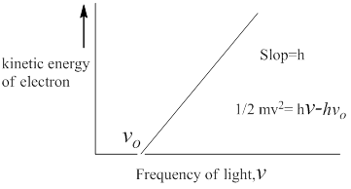
4.All metals exhibit the same pattern, but each metal has a different
threshold frequency.
Einstein made an extraordinary assumption.
He suggested that the beam of light is really a stream
of particles.
These particles of light are now called photons.
The mass of a photon is given by the Einstein
equation of mass-energy equivalence
E= mc² …….1
Using Plank's quantum theory of radiation as a
starting point, Einstein deduced that each photon
must possess energy E , given by the equation
E= hv …….2

Slide 16
If the frequency of photons is such that hv is exactly equal to the energy that binds the electrons in the metal, then the light will have just enough energy to knock the electron loose. If we use light of a higher frequency, then not only will the electrons be knocked loose, but they will also acquire some kinetic energy, this situation is summarized by the equation
hv = KE+BE (KE= kinetic energy, BE= binding energy) …….3
Combining Eq.1with 2
m = $\frac{hv}{c^{2}}$ ……4
The momentum (p) of photon is
P= mv = mc …….5
But λ = $\frac{c}{v}$ …….6
thus λ = $\frac{h}{p}$ …….7

Slide 17
For standing wave
2πr = nλ …….8
Substituting for λ from Eq.7, we have
2πr= $n( \frac{h}{p} )$ …….9
r$p$=$n( \frac{h}{2π} )$( angular momentum) …….10

Slide 18
Example 5:
Calculate the wave length of the "particle" in the following two cases:
The fastest serve in tennis is about 140 miles per hour, or 62 m/s. associated with a 6.0x10⁻² kg tennis ball traveling at this velocity.
wave length associated with an electron moving at 62 m/s.
Ans./ (a) λ = $\frac{h}{mv}$ = $\frac{6.63 x {10}^{−34}J.s}{6.0 x {10}^{−2}kg x 62 m/s}$The conversion factor is 1J=1kg.m²/s²
λ =1.8 x 10⁻³⁴ m (this is an exceedingly small wavelength)
(b) λ = $\frac{h}{mv}$ = $\frac{6.63 x {10}^{−34}J.s}{9.1095 x{10}^{−31}kg x 62 m/s}$
λ =1.2 x 10⁻⁵ m or 1.2 x 10⁴ nm (which is in infrared region)

Slide 19
Example 5:
The minimum energy needed to remove an electron from pottasium metal is 3.7x10⁻¹⁹ J. Will photons of frequencies 4.3x10¹⁴ s⁻¹ (red light) and 7.5x10¹⁴s⁻¹ (blue light) tigger the photoelectric effect ? If so, how fast will the ejected electron move?
Ans./ E_{red photon} = hv = ($6.63 x {10}^{−34}J.s$) (4.3x10¹⁴ s⁻¹ ) = 2.8x10⁻¹⁹ J
E_{blue photon}= hv = ($6.63 x {10}^{−34}J.s$) (7.5x10¹⁴s⁻¹) = 5.0x10⁻¹⁹ J
According to this calculations, a photon of red light does not have enough energy to overcome the force that bind the electron to the metal. Ablue photon, however, will eject an electron from the surface of potassium metal because its energy exceeds the threshold value, the extra energy transferred to electron as a kinetic energy
hv = hv_{o}+ Ke_{electron} KE_{electron}=hv – hv_{o} KE_{electron}= 5.0x10⁻¹⁹ J - 3.7x10⁻¹⁹ J = 1.3x10⁻¹⁹ J
Ke_{electron} = $\frac{m_{elecrton v^{2}}}{2} v$ = $\sqrt{\frac{2kE}{m}}$ = $\sqrt{\frac{2(1.3x10−19 kg {m^{2}s}^{−2}}{9.1095 x{10}^{−31}kg}} v$= 5.3 x 10⁵ms⁻¹

Slide 20
The spectrum of the hydrogen atom
The transition energy ( E_{H})of an electron jumpin the hydrogen atom is the energy difference between an initial state I and the final state II thus:
E_{H} = E_{II} - E_{I}
E_{H}=$− \frac{2π^{2}m_{e}e^{4}}{{n_{II}}^{2}h^{2}}−( −\frac{2π^{2}m_{e}e^{4}}{{n_{I}}^{2}h^{2}} )$
E_{H}=$\frac{2π^{2}m_{e}e^{4}}{h^{2}}$[$\frac{1}{{n_{I}}^{2}}−\frac{1}{{n_{II}}^{2}}$]
Replacing E_{H} with its equivalent frequency of light from last Eq., we have
ʋ _{H}= $\frac{2π^{2}m_{e}e^{4}}{h^{3}}$[$\frac{1}{{n_{I}}^{2}}−\frac{1}{{n_{II}}^{2}}$] ………30

Slide 22
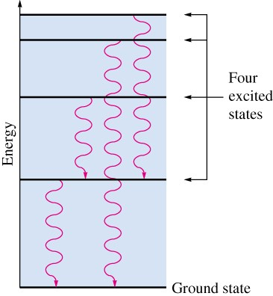
The Rydberg equation is an empirical equation that relates the wavelengths of the lines in the hydrogen spectrum.
$\frac{1}{λ}$ = R_{H} [ $\frac{1}{n12}$ - $\frac{1}{n 22}$ ]
R_{H} is the Rydberg constant
R_{H} =1.097 ×10⁷ m⁻¹
n₁ < n₂
n’s refer to the numbers of the energy levels
in the emission spectrum of hydrogen.
Figure 6: Each photon emitted by an excited hydrogen
atom corresponds to a particular energy change in the
hydrogen atom

Slide 23
Example 5:
Calculate the wave number (ῡ_{H}) for (n=1) and (2, 3, 4)
Ans./
ῡ_{H}= 109678($\frac{1}{1^{2}}$- $\frac{1}{2^{2}}$ ) = 82259 cm⁻¹
ῡ_{H}= 109678 ($\frac{1}{1^{2}}$- $\frac{1}{3^{2}}$ ) = 97492 cm⁻¹
ῡ_{H}= 109678 ($\frac{1}{1^{2}}$- $\frac{1}{4^{2}}$ ) = 102823 cm⁻¹

Slide 24
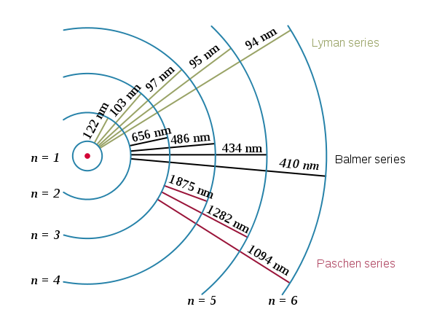

Slide 25
Example 6:
What is the wavelength of light emitted when the hydrogen atom’s energy changes from n = 4 to n = 2?
n₂ = 4 and n₁ = 2
$\frac{1}{λ}$ = R_{H} [ $\frac{1}{n12}$ - $\frac{1}{n22}$ ]
$\frac{1}{λ}$ = 1.097 ×10⁷ m⁻¹ [ $\frac{1}{22}$ - $\frac{1}{42}$ ]
$\frac{1}{λ}$ = 1.097 ×10⁷ m⁻¹ [ $\frac{1}{4}$ - $\frac{1}{16}$ ]
$\frac{1}{λ}$ = 1.097 ×10⁷ m⁻¹ [ 0.250 – 0.0625]
$\frac{1}{λ}$ = 1.097 ×10⁷ m⁻¹ [ 0.1875]
$\frac{1}{λ}$ = 2.057 × 10⁷ m⁻¹
$λ$ = 4.862 × 10⁻⁷ m

Slide 26
Figure 7: When excited hydrogen atoms return to lower energy states, they emit photons of certain energies, and thus certain colors

Slide 27
Bohr Theory
In 1913 Neils Bohr incorporated Planck’s quantum theory into the hydrogen spectrum
explanation. 
Here are the postulates of Bohr’s theory.
1- Atom has a number of definite and discrete energy levels (orbits) in which an electron may exist without emitting or absorbing electromagnetic radiation.
As the orbital radius increases so does the energy
1 < 2 < 3 < 4 < 5......
2- An electron may move from one discrete energy level (orbit) to another, but, in so doing,
monochromatic radiation is emitted or absorbed in accordance with the following equation.
E₂ - E₁ = ΔE = $\frac{hC}{λ}$
E₂ > E₁

Slide 28
Figure 8: The Bohr Model of the Atom Hydrogen Spectrum

Slide 29
Energy is absorbed when electrons jump to higher orbits
n = 2 to n = 4 for example.
Energy is emitted when electrons fall to lower orbits
n = 4 to n = 1 for example
3- An electron moves in a circular orbit about the nucleus and it motion is governed by the ordinary laws of mechanics and electrostatics, with the restriction that the angular momentum of the electron is quantized (can only have certain discrete values).
angular momentum = mvr = nh/2πr
h = Planck’s constant n = 1,2,3,4,...(energy levels) v = velocity of electron
m = mass of electron r = radius of orbit.

Slide 30
Figure 9: The Bohr model of the hydrogen atom

Slide 31
Bohr’s Model
Distances between energy levels decreases as the energy increases.
- light given off in a transition from the second energy level to the first has a higher energy than light given off in a transition from the third to the second, etc.
- Electrons “orbit” the nucleus much like planets orbiting the sun.
1st energy level can hold 2e⁻¹, the 2nd 8e⁻¹, the 3rd 18e⁻¹, etc.
- farther from nucleus = more space = less repulsion.
The highest energy occupied ground state orbit is called the valence shell

Slide 32
Problems with the Bohr Model
Only explains hydrogen atom spectrum and other 1 electron systems.
Neglects interactions between electrons.
Assumes circular or elliptical orbits for electrons - which is not true.
The Wave Nature of the Electron
In 1925 Louis de Broglie said that electrons have wave-like properties.
- The electron wavelengths are described by the de Broglie relationship.
$λ$ = $\frac{h}{mv}$ h = Planck’s constant
m = mass of particle
v = velocity of particle

Slide 33
Consequently, we now know that electrons (in fact - all particles) have both a particle and a wave like character.
-This wave-particle duality is a fundamental property of submicroscopic particles.
Example 5
Determine the wavelength, in m, of an electron, with mass 9.11 x 10⁻³¹ kg, having a velocity of 5.65 x 10⁷ m/s. Remember Planck’s constant is 6.626 x 10⁻³⁴ J.s which is also equal to 6.626 x 10⁻³⁴ kg m²/s².
$λ$ = $\frac{h}{mv} λ$ = $\frac{\text{6.626}\text{×}\text{10}\text{−}\text{34} \text{kg} \text{m}\text{2 }\text{.}\text{s}\text{2} }{\text{(}\text{9.}\text{11}\text{×}\text{10}\text{−}\text{31} \text{kg})(\text{5.}\text{65 }\text{×}\text{10}\text{7} \text{m}\text{/}\text{s})}$
$λ$ = 1.29 ×10⁻¹¹ m

Slide 34
Thank you very much

